Slide 1
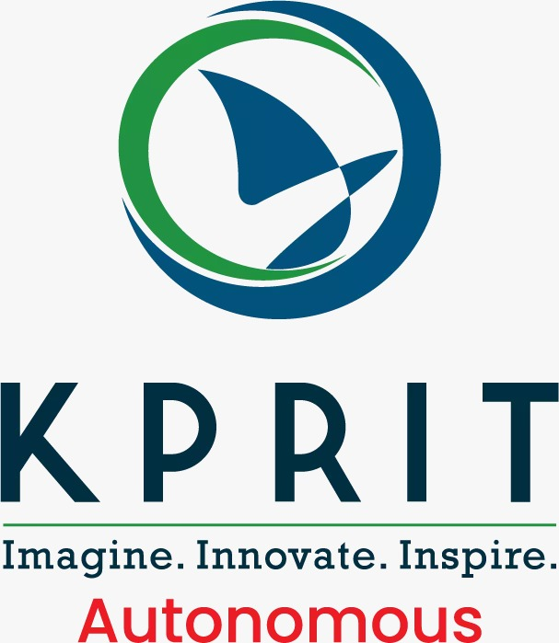
KOMMURI PRATAP REDDY INSTITUTE OF TECHNOLOGY
(UGC-Autonomous Institution) Ghanpur(V), Ghatkesar(M), Medchal(D), Hyderabad-500088
DEPARTMENT OF COMPUTER SCIENCE ENGINEERING (AI&ML)
MAJOR PROJECT STAGE-1, REVIEW-1
ROLE-BASED MULTI-AGENT LLMs
for Transparent Decision-Making
A simulated decision-making committee of Advocate, Skeptic, Compliance-Checker
and Adjudicator agents — built with CrewAI / AutoGen
Under The Guidance:
Dr. Pulime Satyanarayana
PROFESSOR
DEPARTMENT OF CSE (AI&ML)
Presented by:
N. Vishnu Kumar — 23RA1A66D4
G. Vinay — 23RA1A66D1
M. Yeshwanth — 23RA1A66E0
K. Shiva Sai — 23RA1A66A5

Slide 2
ABSTRACT
Abstract
Automated decision-making systems in domains such as loan approval and academic admissions often function as opaque black boxes, making outcomes difficult to understand, trust, or contest. This project addresses that gap by simulating a transparent decision-making committee using multiple Large Language Model (LLM) agents, each assigned a distinct role: an Advocate arguing for the applicant, a Skeptic challenging weak points, and a Compliance-Checker ensuring adherence to fairness guidelines. These agents engage in a structured, multi-round debate, after which a final Adjudicator agent synthesizes the arguments and renders a decision, with the complete transcript logged in JSON format for auditability. The system is built using CrewAI or AutoGen on a synthetic loan/admissions dataset, and bias probes — swapping demographic attributes across identical profiles — measure decision consistency, extending multi-agent debate techniques toward explainable, auditable AI decision support.
2

Slide 3
LITERATURE SURVEY — PART 1
Foundations of Multi-Agent Debate
1
Du et al. (2023) — arXiv:2305.14325
Introduced multi-agent debate: several LLM instances critique each other over multiple rounds, improving factual accuracy and reasoning versus single-agent prompting.
2
Wu et al. (2024) — AutoGen, COLM
Presented AutoGen, an open-source framework for building multi-agent LLM applications with customizable agents and flexible conversation patterns — one of the two frameworks used in this project.
3
Comparative study (2024) — AutoGen vs. CrewAI vs. TaskWeaver
Benchmarked the three leading multi-agent orchestration frameworks on collaborative code-generation tasks, informing the choice of framework for this project.
3

Slide 4
LITERATURE SURVEY — PART 2
Bias, Fairness & Risk in Agent Systems
1
Emergent Bias and Fairness in Multi-Agent Decision Systems — arXiv:2512.16433
Tested multi-agent debate on the German Credit and Adult Income loan datasets; found debate can either amplify or reduce bias depending on agent composition — directly motivating this project's bias-probing objective.
2
Emergence of Biased Consensus in Multi-Agent LLM Debates — arXiv:2608.02827
Showed that conformity among debating agents can trigger a phase transition into collective bias, and that agent heterogeneity helps suppress it.
3
Weidinger et al. (2022) — ACM FAccT
Proposed a taxonomy of risks posed by language models, including discrimination and lack of accountability — grounds the role of this project's Compliance-Checker agent.
4

Slide 5
EXISTING SYSTEM
Single-Model Decision Pipelines
Applicant Data
→
Single ML/LLM Model
→
Final Decision
Limitations
Minimal explanation accompanies the final decision
No mechanism to challenge or verify the decision before finalization
Bias goes undetected — no structured probing step
Difficult to audit or hold accountable
5

Slide 6
PROPOSED SYSTEM
A Committee of Role-Based Agents
1
2
3
4
Advocate
Skeptic
Compliance-Checker
Adjudicator
Argues in favor of the applicant / case
Raises counterpoints, challenges weak reasoning
Flags policy or fairness violations
Synthesizes debate into a final, justified decision
Built with CrewAI / AutoGen • structured debate rounds • JSON transcript logging • bias probes on synthetic datasets
6

Slide 7
TECHNICAL STACK
Tools & Technologies Powering the System
1
2
3
Orchestration
Language Models
Programming
CrewAI and AutoGen for role-based multi-agent coordination
LLM API backend (GPT-4 / Claude) powering each agent
Python 3.11 as the core implementation language
4
5
6
Data & Logging
Datasets
Dev & Version Control
Pandas for data handling; structured JSON transcript logs
Synthetic loan & admissions data (German Credit, Adult Income)
VS Code for development; Git / GitHub for versioning
7

Slide 8
OBJECTIVES
What This Project Sets Out to Do
1
Design a role-based multi-agent debate protocol for decision-making tasks
2
Implement transparent, structured logging of agent reasoning as JSON transcripts
3
Evaluate decision quality and consistency against single-agent baselines
4
Probe the system for bias using synthetic loan and admissions datasets
5
Assess whether debate improves fairness and explainability over black-box models
8

Slide 9
METHODOLOGY
Debate-Driven Decision Workflow
Input Case
→
Advocate Argues
→
Skeptic Challenges
→
Compliance Checks
→
Adjudicator Decides
→
JSON Transcript
Each stage of the loop is captured verbatim, giving a full audit trail from raw input to final verdict.
Evaluation: synthetic loan & admissions datasets • multi-agent vs. single-agent comparison • demographic bias probes
9

Slide 10
EXPECTED OUTCOMES
What the Project Will Deliver
1
2
3
4
5
Working prototype
Traceable transcripts
Comparative results
Bias analysis report
Reusable framework
Auditable, structured multi-agent decision-making system
JSON logs showing full reasoning behind every decision
Accuracy & consistency: multi-agent vs. single-agent
Where debate reduces or exposes disparate outcomes
Extensible beyond loans and admissions use cases
10

Slide 11
REFERENCES
References
1
Du, Y., Li, S., Torralba, A., Tenenbaum, J. B., & Mordatch, I. (2023). Improving Factuality and Reasoning in Language Models through Multiagent Debate. arXiv:2305.14325.
5
Emergent Bias and Fairness in Multi-Agent Decision Systems (2025). arXiv:2512.16433.
2
Wu, Q., Bansal, G., Zhang, J., et al. (2024). AutoGen: Enabling Next-Gen LLM Applications via Multi-Agent Conversations. First Conference on Language Modeling (COLM).
6
Emergence of Biased Consensus in Multi-Agent LLM Debates (2026). arXiv:2608.02827.
3
Benchmarking Large Language Models for Multi-Agent Systems: A Comparative Analysis of AutoGen, CrewAI, and TaskWeaver (2024). arXiv preprint.
7
CrewAI (2024). Framework Documentation — Role-Based Orchestration for Autonomous Multi-Agent Systems. crewai.com
4
Weidinger, L., Uesato, J., Rauh, M., et al. (2022). Taxonomy of Risks Posed by Language Models. ACM Conference on Fairness, Accountability, and Transparency (FAccT), 214–229.
8
Microsoft AutoGen (2024). Open-Source Multi-Agent Framework Documentation. microsoft.github.io/autogen
11

